Slide 1


AICTE Sponsored International Conference on Advances in Computer Engineering & Communication Technology (ICACET-2021)
Morressier Paper Id: 40
Paper Title: English -Malayalam Bilingual Assistive Aid Using Multi Modal Machine Learning Technologies
Author:Lekshmy H O ,Dr.Swaminathan Jayaram
22nd, 23rd October 2021

Slide 2
Contents
Introduction
Problem Formulation
Objective
Methodology
Results and Discussions
Conclusions and future scope
References

Slide 3
Introduction
Around 250 million people around the world suffers due to vision loss.
Over 70 percent of the blind population lives in Multilingual developing countries.
India itself contributes 15% percent of the blind population.
A huge assortment of vision assistive gadgets are available in Market.
Major part of vision aids are customized for English speaking users.
People in multilingual developing countries often face hardship in using aids due to language barrier.
Some gadgets make use of Machine Translation API s for customization.
Statistical Machine Translation and Neural machine Translation two common translation techniques.

Slide 4
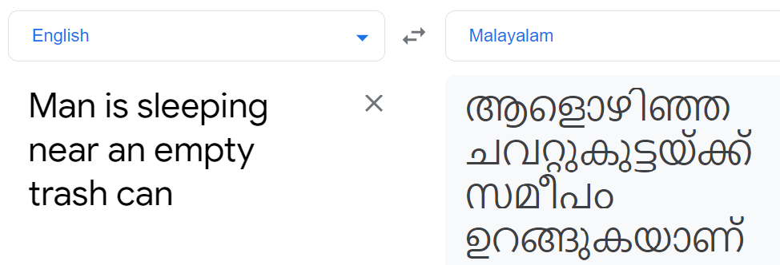
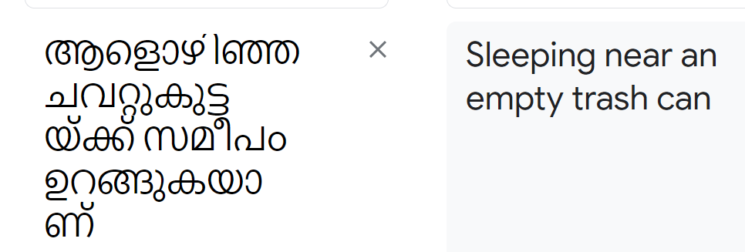
Problem Formulation
Statistical machine translation and Neural machine translation doesn’t work well on low resource languages.
This is mainly due to unavailability of training data and structural differences between languages.
APIs produce literal/word by word translations in case of Indian languages, especially Dravidian languages like Malayalam.
This creates misinterpretations and negatively effect vision aid performance.
Fig English Malayalam Translations from API

Slide 5
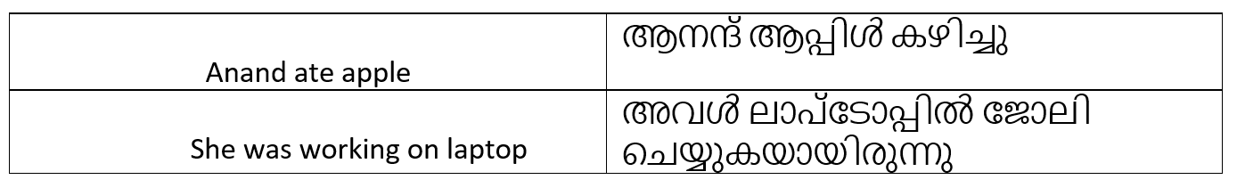
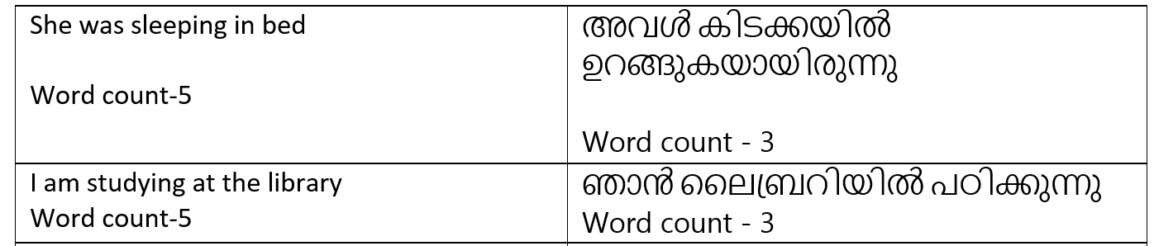
Challenges in Low Resource Language Translation
English Malayalam Translation -Challenges
Structural Divergence
Morphological Divergence
English | Malayalam
Slightly Agglutinative | Agglutinative
Treat grammar and root words separately | Complex words by combining morphemes
Comparatively less unique words-Large sentence length | More unique words-small sentence length
English | Malayalam
Subject-Object-Verb (SOV) structure | Subject-Verb-Object (SVO) structure
Prepositions are more common | Postpositions are more common

Slide 6
Comparative Analysis of English and Malayalam
Fig 2: Comparative analysis of English and Malayalam
Problem Statement:
To find an efficient machine translation mechanism to translate high resource English language into low resource Malayalam language in assistive devices.

Slide 7
Objective
To Develop a multi-linguistic user-friendly vision assistive aid than can
Capture Images upon instructions
Can Produce proficient textual descriptions from images.
Can translate descriptions into low-resource Indian language specially Malayalam.
Can produce Speech outputs.

Slide 8
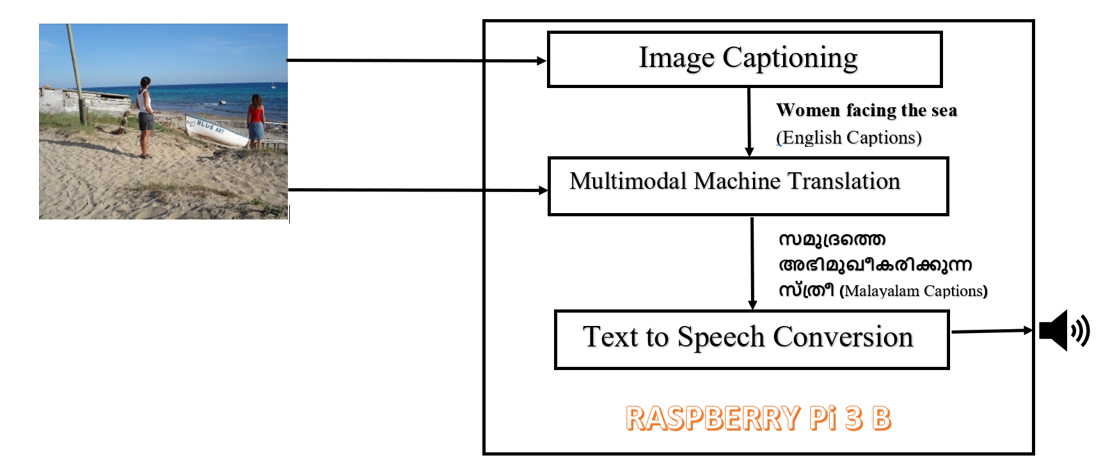
Methodology
Three different functionalities are integrated inside this device.
1.IOT Sensor network
2.Image Captioning
3.Multi modal machine translation
Fig 3: Basic Structure of Model

Slide 9
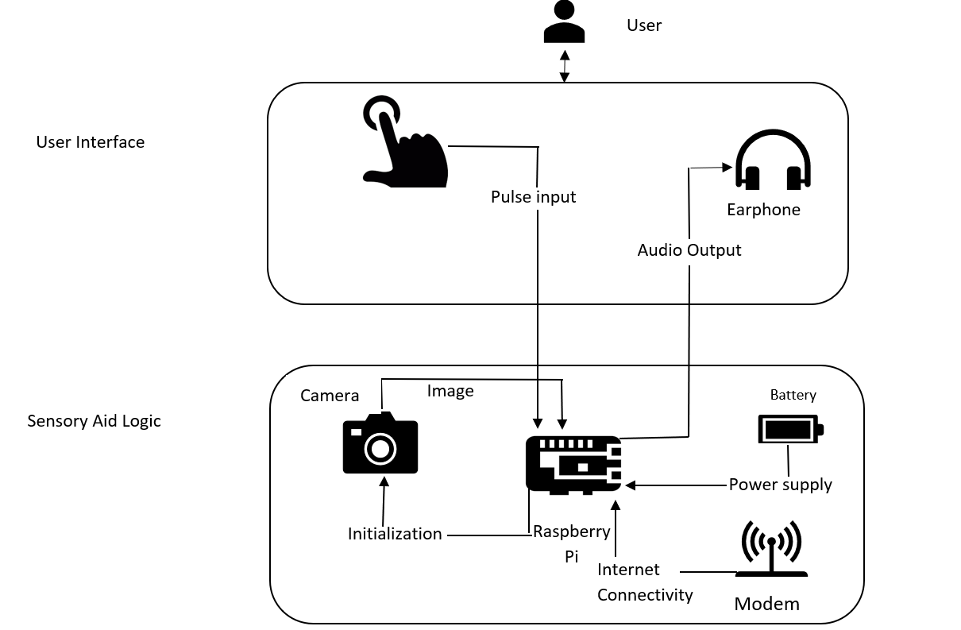
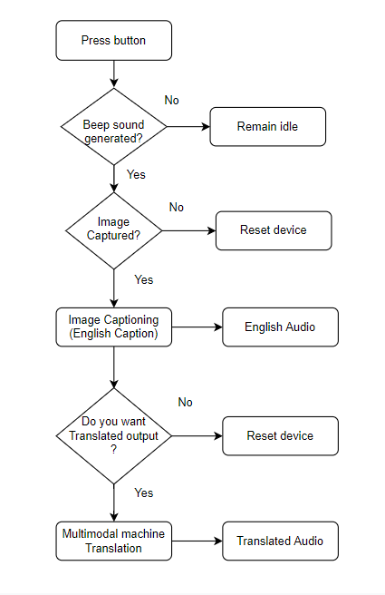
Schematic Design & Workflow
Fig: Schematic design of Model
Fig: Work Flow of Model

Slide 10
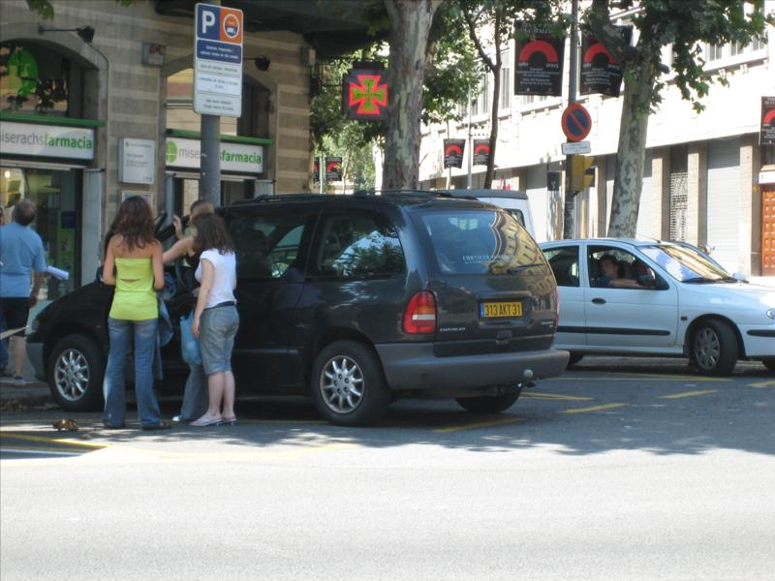
Detailed Methodology
Image
1
2
Image Features
CNN
RNN
English Captions
CNN
Multimodal
Machine Translation
Image
Attention
1
Malayalam Captions
Image captioning
2
Multimodal Machine Translation
Fig: Detailed Methodology of Model

Slide 11
Multi Modal Machine Translation-Implementation
Eo
Eo
ENCODER
Image Encodings
Hs
Hs
Hs
LSTM
LSTM
LSTM
DECODER
Cs
Cs
Cs
Source -Text Embeddings
Target decoded sequence
DECODER
Hs
ENCODER
LSTM
Dense Layer
SoftMax layer
Cs
Hs-Hidden state
Cs-Cell state
Eo-Encoder output
Input decoded sequence
Fig: Encoder-Decoder Circuit architecture

Slide 12
FrameWork
Keras
Tensor Flow
Tensor Flow Lite
GPU used for validation is NVIDIA Tesla K80 GPU with Google Colab.
Main Packages
PyAudio
SpeechRecognition
gTTS(Google Translate’s Text-to-Speech API)
Gensim
Natural Language Toolkit

Slide 13
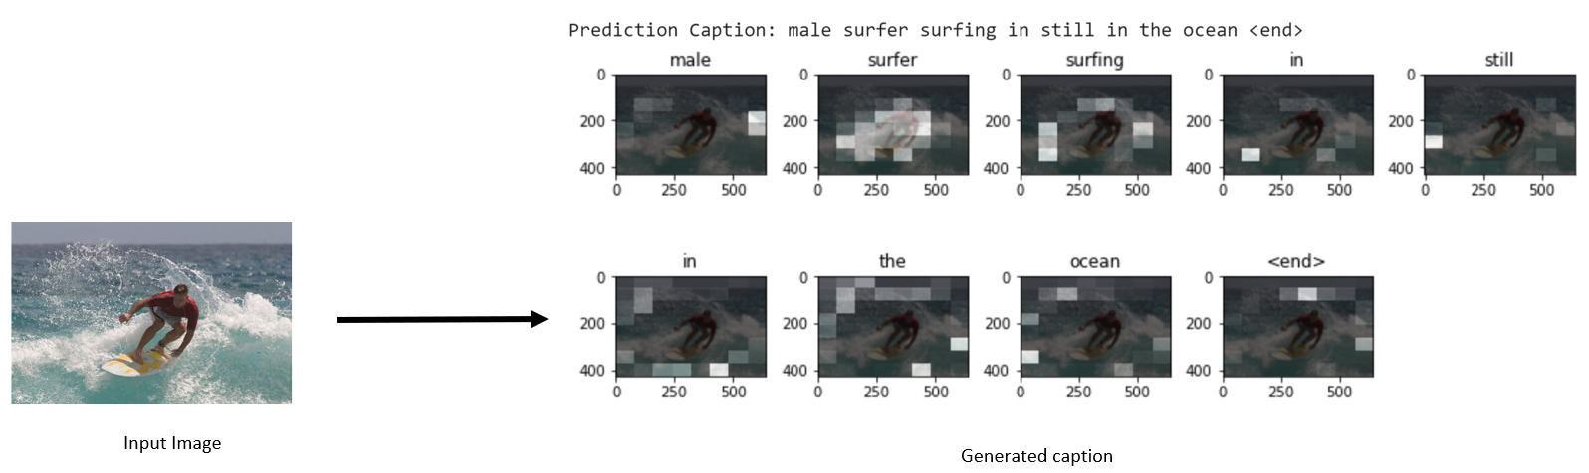
Results
 | Image Captioning
Dataset | Coco
Size | 330k
Release Year | 2014
Content | Image + English Caption
BLEU Score | 51

Slide 14
Multimodal Machine Translation-Results
 | English – Malayalam Translation
Dataset | Visual Genome Malayalam
Size | Training- 29k Testing-1 k Validation-1.6 k
Release Year | 2021
Content | Images+English captions+Malayalam captions(reference)
Competition | WAT Challenge
Root Datset | Coco dataset
BLEU Score | 37

Slide 15
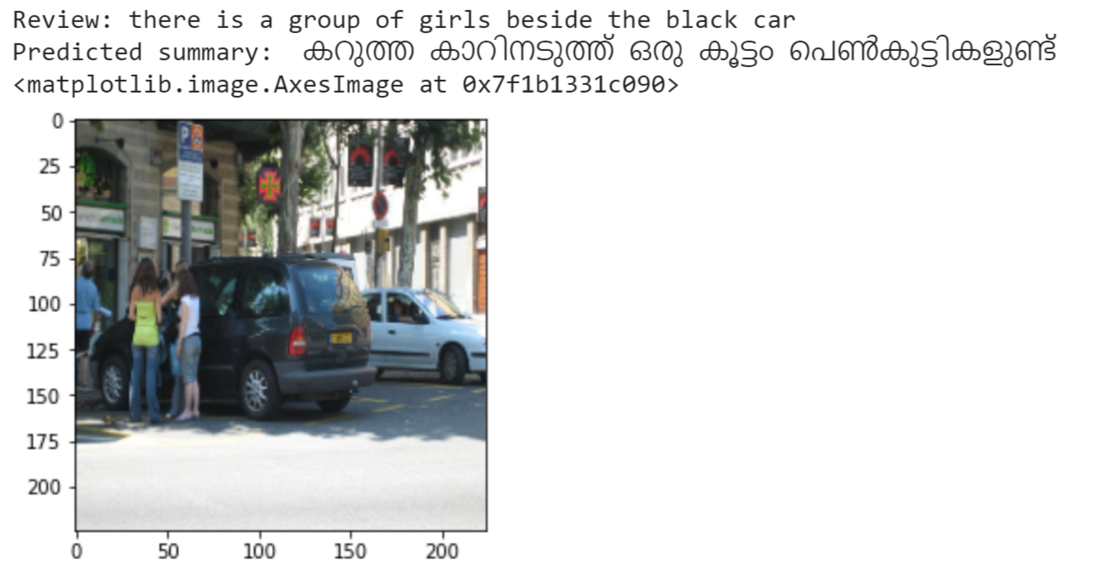
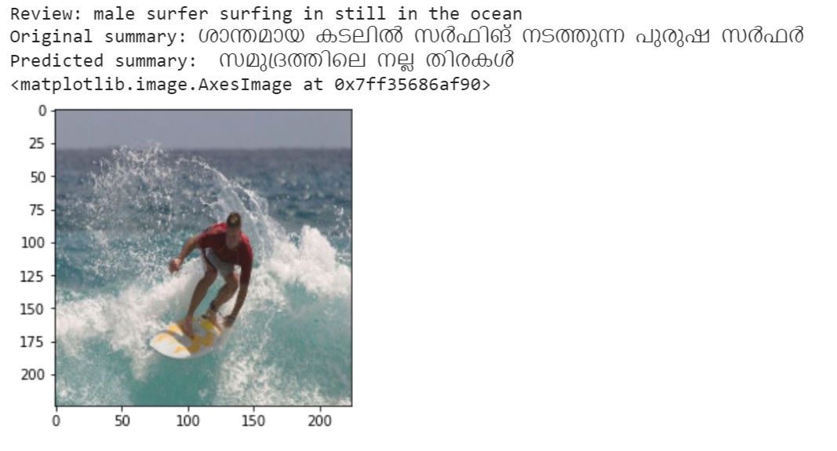
Multimodal Machine Translation-Results
BEST CASE
WORST CASE
BLEU Score
100
BLEU Score
10

Slide 16
Conclusions and future scope
Developed a Bilingual assistive vision aid that can convert captions from English to Malayalam using Multimodal machine Translation Techniques
This device is affordable and can produce translations on real time.
Structural Divergence and Morphological divergence can be solved using MMT Models.
This methods can apply on smart devices like travel aid
A multilingual device can be formed by incorporating more language models.
Performance can be improved by incorporating more modalities like Speech,Video

Slide 17
Reference
[1] Mohammad O. A. Aqel et al. “Review of Recent Research Trends in AssistiveTechnologies for Rehabilitation”. In:2019 International Conference on PromisingElectronic Technologies (ICPET). 2019, pp. 16–21.doi:10.1109/ICPET.2019.00011.
[2] Peter Ackland, Serge Resnikoff, and Rupert Bourne. “World blindness and visualimpairment: despite many successes, the problem is growing”. In:Community Eye Health30.100 (2017), p. 71.
[5] Raj Dabre, Chenhui Chu, and Anoop Kunchukuttan. “A Survey of Multilingual NeuralMachine Translation”. In:ACM Comput. Surv.53.5 (Sept. 2020).issn: 0360-0300.doi:10.1145/3406095.
[6] Ding Liu et al. “A Survey of Low Resource Neural Machine Translation”. In:2019 4thInternational Conference on Mechanical, Control and Computer Engineering (ICMCCE).2019, pp. 39–393.doi:10.1109/ICMCCE48743.2019.00017.
[7] Alexy Bhowmick and Shyamanta Hazarika. “An insight into assistive technology for thevisually impaired and blind people: state-of-the-art and future trends”. In:Journal onMultimodal User Interfaces11 (Jan. 2017), pp. 1–24.doi:10.1007/s12193-016-0235-6.
[8] Muiz Ahmed Khan et al. “An AI-Based Visual Aid With Integrated Reading Assistant forthe Completely Blind”. In:IEEE Transactions on Human-Machine Systems50.6 (2020),pp. 507–517.doi:10.1109/THMS.2020.3027534

Slide 18
Reference
[ 9] Chetan Amritkar and Vaishali Jabade. “Image Caption Generation Using Deep LearningTechnique”. In:2018 Fourth International Conference on Computing CommunicationControl and Automation (ICCUBEA). 2018, pp. 1–4.doi:10.1109/ICCUBEA.2018.8697360
[10] Amey Hengle et al. “Smart Cap: A Deep Learning and IoT Based Assistant for the VisuallyImpaired”. In:2020 Third International Conference on Smart Systems and InventiveTechnology (ICSSIT). 2020, pp. 1109–1116.doi:10.1109/ICSSIT48917.2020.9214140
[11] A. Karmel et al. “IoT based Assistive Device for Deaf, Dumb and Blind People”. In:Procedia Comput. Sci.165 (Jan. 2019), pp. 259–269.issn: 1877-0509.doi:10.1016/j.procs.2020.01.080
[12] Iacer Calixto, Qun Liu, and Nick Campbell. “Doubly-Attentive Decoder for Multi-modal Neural Machine Translation”. In:Proceedings of the 55th Annual Meeting of theAssociation for Computational Linguistics (Volume 1: Long Papers). Vancouver, Canada:Association for Computational Linguistics, July 2017, pp. 1913–1924.doi:10.18653/v1/P17-1175
[13] Sahinur Laskar et al.English to Hindi Multi-modal Neural Machine Translation and HindiImage Captioning. Nov. 2019.
[14] Yuqing Song et al. “Enhancing Neural Machine Translation with Dual-Side MultimodalAwareness”. In:IEEE Transactions on Multimedia(2021), pp. 1–1.doi:10.1109/TMM.2021.3092187.
[15] Kelvin Xu et al. “Show, Attend and Tell: Neural Image Caption Generation with VisualAttention”. In:arXiv(Feb. 2015). eprint:1502.03044.url:https://arxiv.org/abs/1502.03044v3.

Slide 19
THANK YOU

